Slide 1
Getting Started with latiz

Slide 2
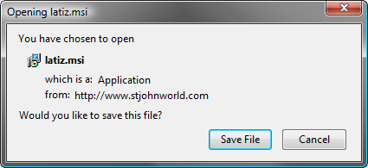

Downloading Latiz Installer
Download the Latiz installer here
You should get a dialog like this
Launch the installer by clicking the latiz.msi installer program

Slide 3
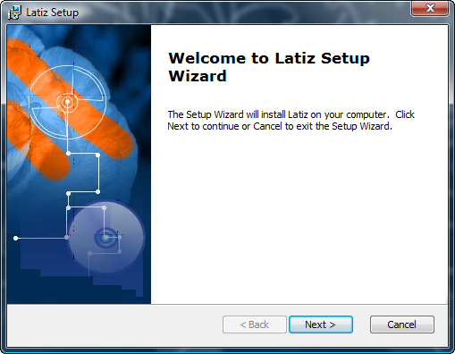
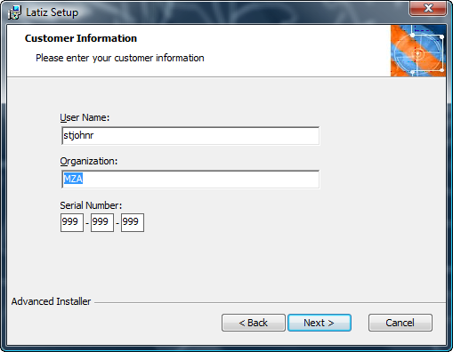
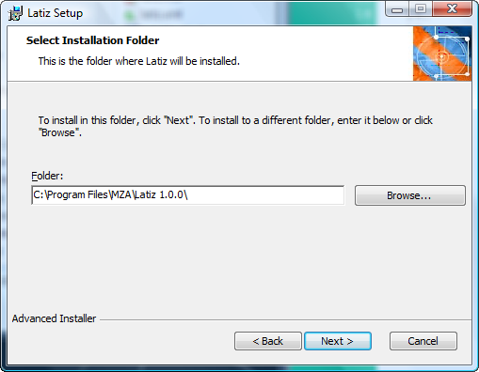
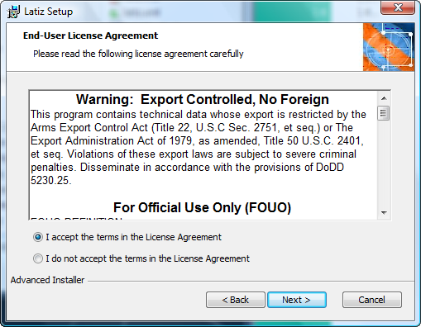
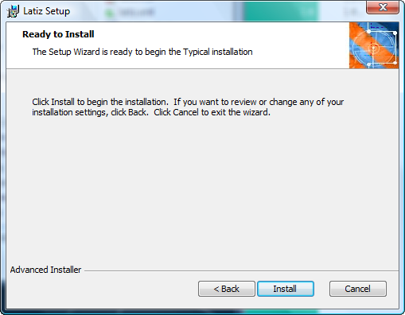
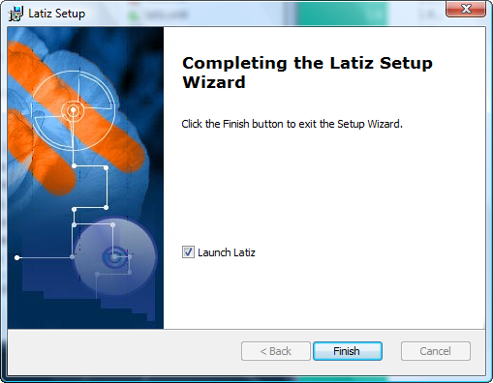
Latiz Installation Process
1
2
3
4
5
6

Slide 4
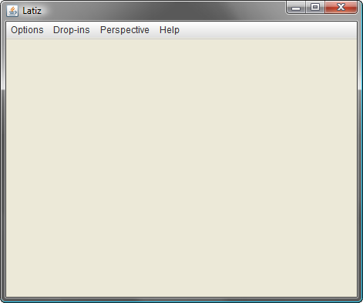
Starting Latiz (for the first time)
No plugins are distributed with Latiz

Slide 5
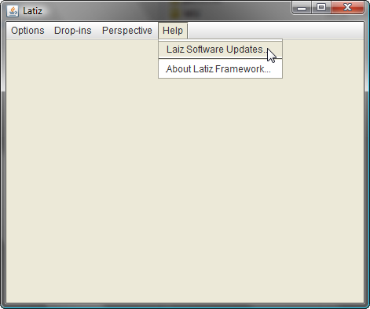
Getting Software Components
To download plugins, launch the Plugin Updated Manager by clicking the menu Help>Latiz Software Updates…

Slide 6
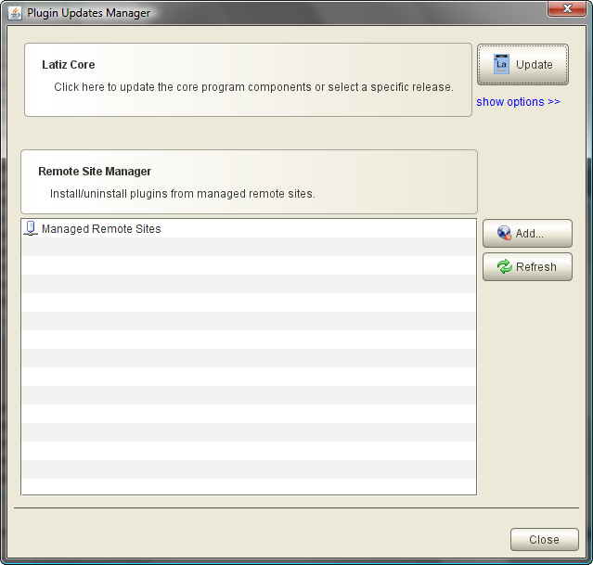
Plugin Update Manager
All plugins should be managed from this dialog

Slide 7

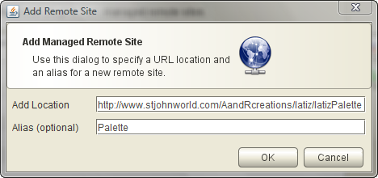
Add Palette Plugin to Latiz
Click the add button on the Plugin Updates Manager
Add Managed Remote Site
URL
http://www.stjohnworld.com/AandRcreations/latiz/latizPalette
Alias (Optional)
Palette

Slide 8
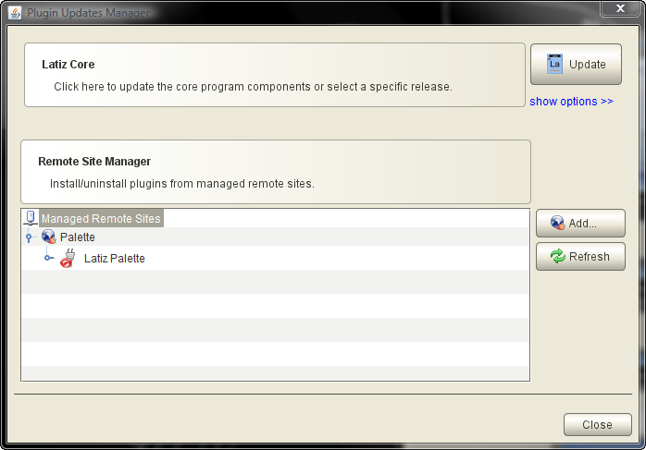
Managed Remote Sites
You should now have Palette under Managed Remote Sites.

Slide 9
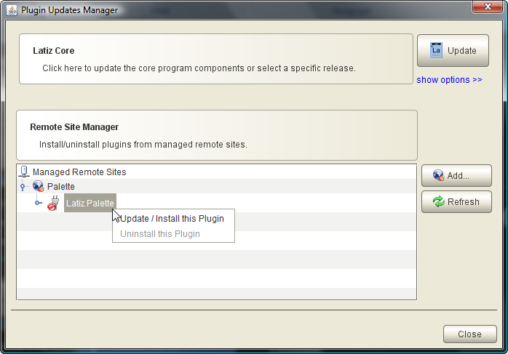
Install Palette in Latiz
Use context menu to install

Slide 10
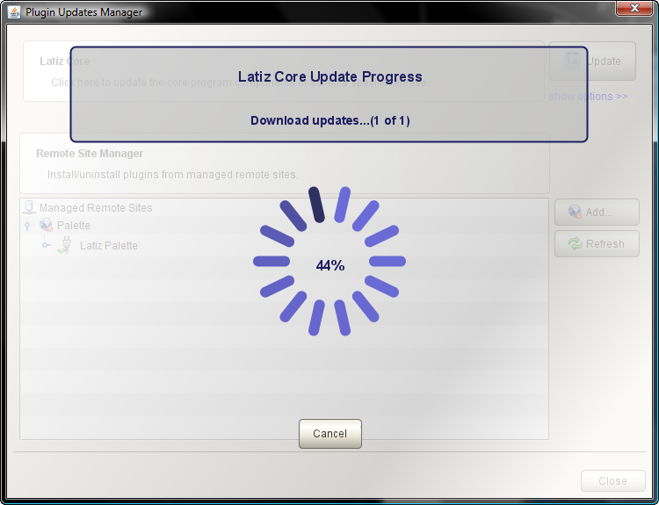
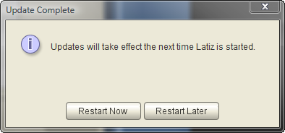
Downloading Progress

Slide 11
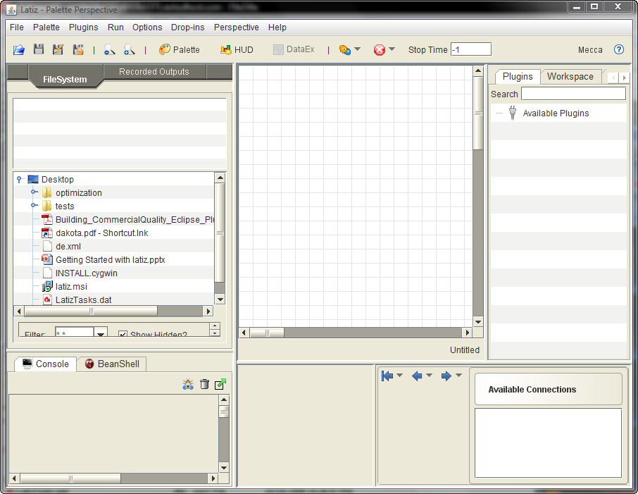
Latiz – Palette Perspective
Upon restart you should have the Palette Perspective installed

Slide 12
Installing Palette Plugins
Use the same process to install Palette Plugins.
Some palette-plugin suite URLs
http://www.stjohnworld.com/AandRcreations/latiz/helcomes
http://www.stjohnworld.com/AandRcreations/latiz/jacsPlugins
http://www.stjohnworld.com/AandRcreations/latiz/stjohnPalettePlugins
http://www.stjohnworld.com/AandRcreations/latiz/masinoPlugins

Slide 13
Installing Additional Perspectives
Some additional perspectives
Cinema, DataExplorer, and LTextEditor
http://www.stjohnworld.com/AandRcreations/latiz/latizPerspectives
Helcomes Classic
http://www.stjohnworld.com/AandRcreations/latiz/???
NASA’s WorldWind
http://www.stjohnworld.com/AandRcreations/latiz/???

